Slide 1
Community and Participation
Year 6

Slide 2
Starter
‘For where two or three gather in my name, there am I with them.’
Matthew 18:20
What do you think Jesus meant by this?
Notes:
Talk partners for 3 minutes
Gather responses

Slide 3
Starter
As humans, we are meant to live in community.
How would you explain what a ‘community’ is?
Notes:
Talk partners for 3 minutes
Gather responses

Slide 4
Catholic Social Teaching

Slide 5
Catholic Social Teaching

Slide 6
Community and Participation
A community is a group of people who live, work or otherwise spend time together.
What communities are you a part of?
Notes:
Write the communities they belong to up on IWB

Slide 7
Community and Participation
As Christians, we are called to live in community with one another.
This means being active members of the world we live in.

Slide 8
Community and Participation
‘Love one another: just as I have loved you ... By this all people will know that you are my disciples.’
John 13:34-35

Slide 9
Community and Participation
‘You shall love the Lord your God with all your heart, and with all your soul, and with all your mind. This is the first and greatest commandment. And the second is you shall love your neighbour as yourself.’
Matthew 22:37-39
Who is your neighbour?

Slide 10
Community and Participation
‘Lord, when was it that we saw you hungry and gave you food, or thirsty and gave you something to drink? And when was it that we saw you a stranger and welcomed you, or naked and gave you clothing? And when was it that we saw you sick or in prison and visited you?”
And the King will answer them: “Truly I tell you, just as you did it to one of the least of these who are members of my family, you did it to me.”’
Matthew 25:31-46

Slide 11
Community and Participation
‘Don’t be observers, but immerse yourself in the reality of life, as Jesus did.’
Pope Francis, World Youth Day, 2013
What do you think Pope Francis meant by ‘immerse yourself in life’?

Slide 12
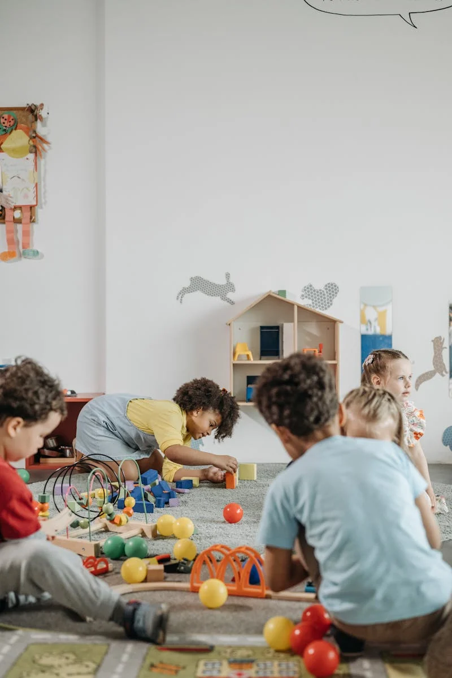
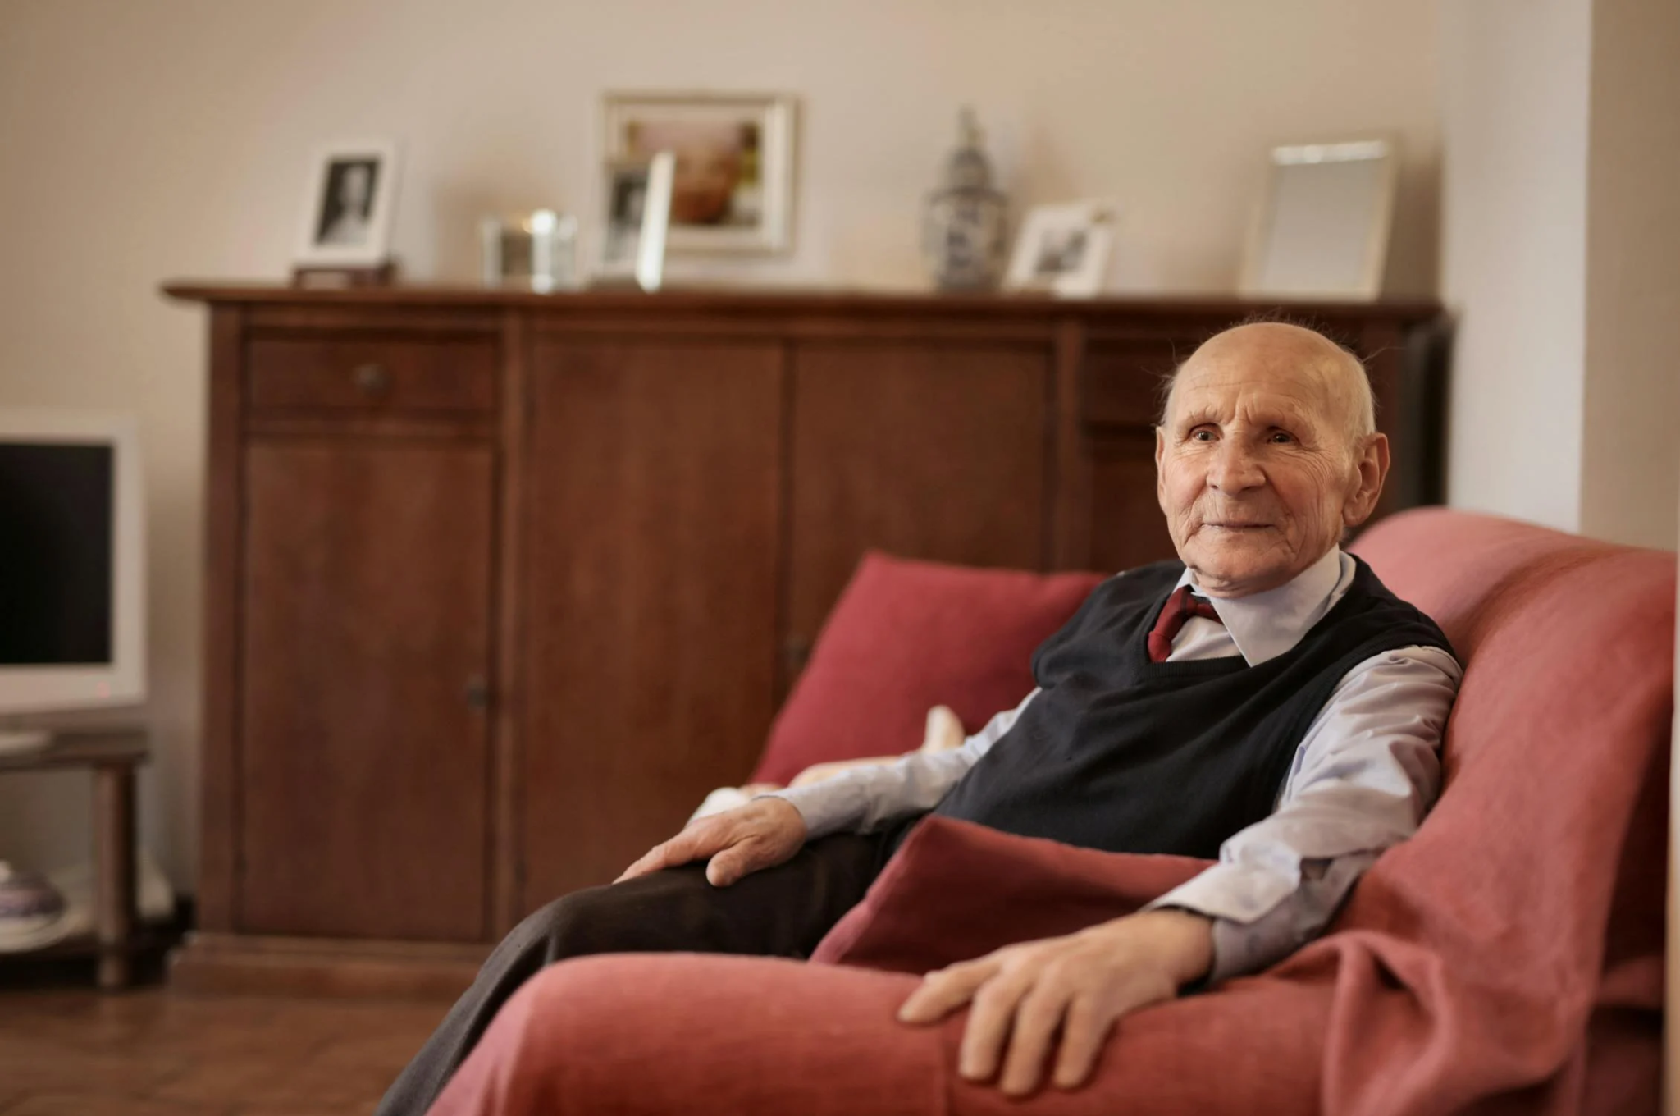
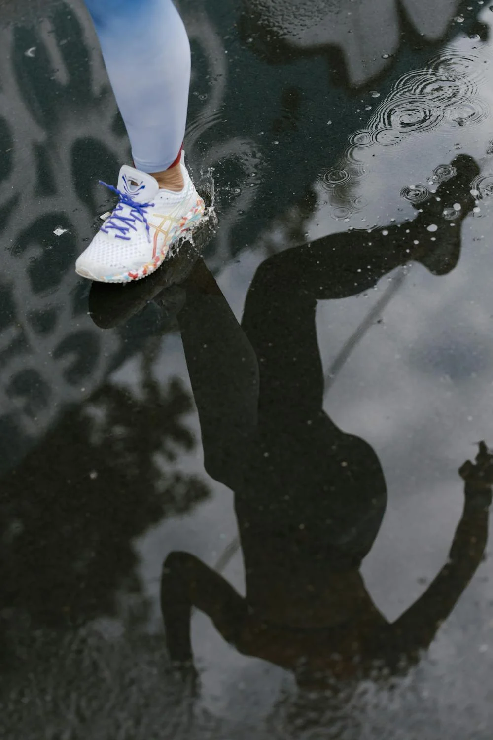
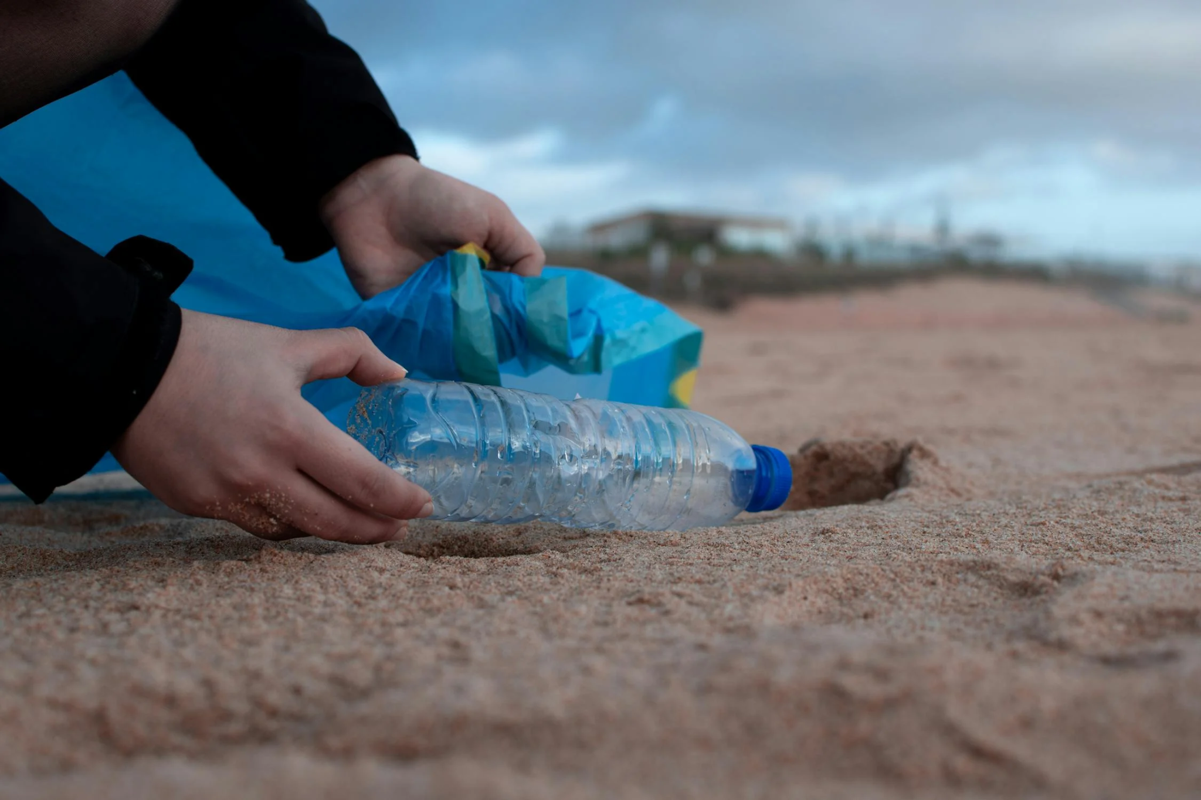
Community Groups/Organisations
Notes:
Care home; play group; park run volunteer; local litter pick

Slide 13
Sharing your talents/qualities
Talents/qualities
Ways to share with your community
Musician
Play a song at the local home for the elderly
Positive person
Be a volunteer at ParkRun
Patient person
Reading with younger children
Notes:
Chn to think of their own additions to this on their whiteboards

Slide 14
Main Activity
As a class, decide on a local group you’d like to reach out to and do so, making it clear what you’re offering. Enjoy making a difference!
Think about:
Why you want to work with this group;
What you can offer;
When this visit will happen.
Notes:
We would love to see the work your pupils produce (with permissions if necessary). Please email their work to: eduril@rcdow.org.uk

Slide 15
Main Activity: Write Up
Write a piece to go into your school newsletter, telling your school community what you’ve been up to
Include:
What group you got involved with and what you did;
What you think the impact on others was;
How you can develop this work in the future;
How Scripture and Pope Francis’ words have influenced you.
Notes:
We would love to see the work your pupils produce (with permissions if necessary). Please email their work to: eduril@rcdow.org.uk

Slide 16
Main Activity: Write Up (Extra Challenge)
Look up parts of the world where there is violence, conflict, extreme poverty; places where people don’t feel the wonder of community and participation. Refer to these places in contrast to the work you’ve done and how community and participation can have such an impact on people’s wellbeing. Research organisations that are trying to help.
Notes:
We would love to see the work your pupils produce (with permissions if necessary). Please email their work to: eduril@rcdow.org.uk

Slide 17
Plenary
‘Carry each other’s burdens, and in this way you will fulfil the law of Christ.’
Galatians 6:2
What do you think it means to ‘carry each other’s burdens’?
In what way might your actions have helped someone else’s burden?
Notes:
Click on the image to link to the hymn: A New Commandment and sing it with children

