Slide 1
Solidarity and Peace
Year 6

Slide 2
Jubilee Year 2025
Pope Francis has declared this year’s Jubilee theme to be: Pilgrims of Hope
In what way is Solidarity and Peace linked to Hope?
Notes:
Pope Francis opened the Holy Door of St Peter’s Basilica on Christmas Eve 2024, marking the beginning of this jubilee year. Pope Francis has called for people of faith to pray for and have deep faith, lively hope and active charity. Explain to the children why this jubilee year is a great time to be very active in charity, which is what we’re working towards in our CST lessons.

Slide 3
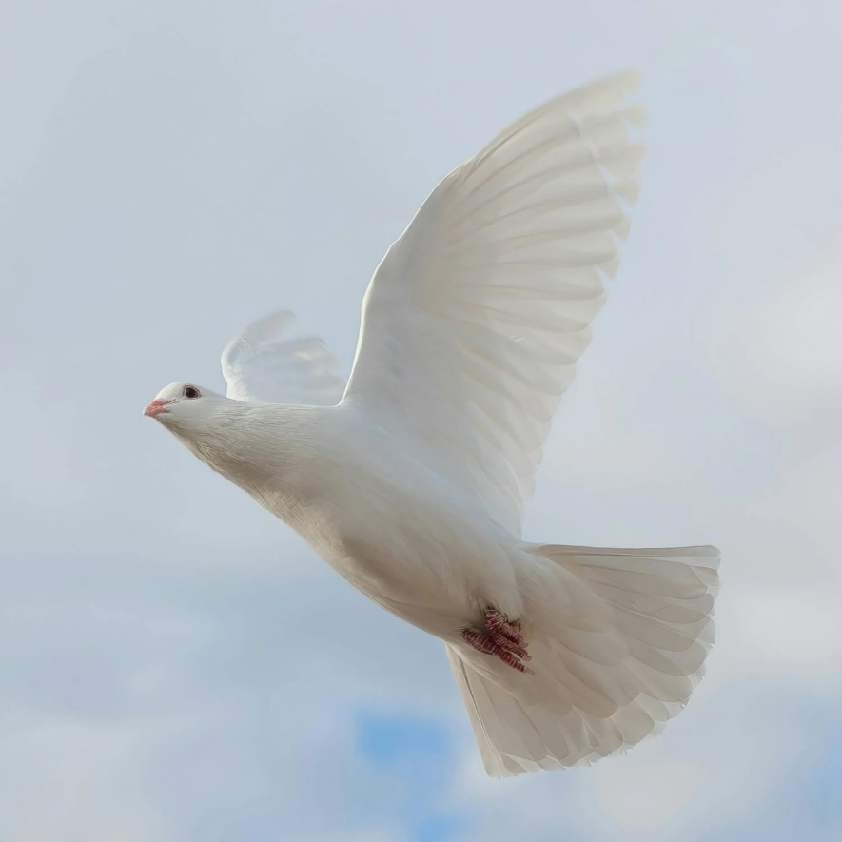
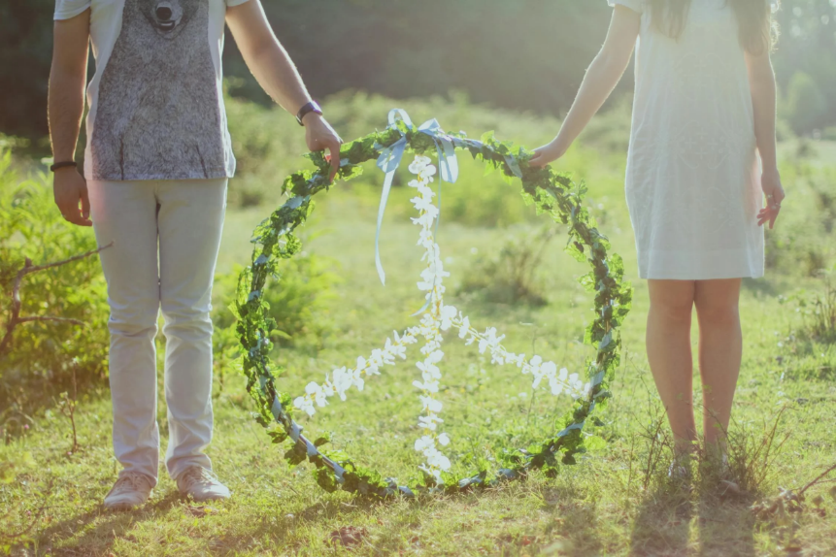
Starter
Notes:
What do these images have in common?

Slide 4
Starter
Peace is more than just ‘no war’.
Peace can mean a lot of things.
How else could you define the word ‘peace’?
Notes:
Talk partners for 3 minutes
Gather responses

Slide 5
Solidarity and Peace
Freedom from disturbance – freedom to live your life as you wish
Free from anxiety or distress – being happy and calm
Make peace – forgiving others when they have done things wrong
At peace with the world – to live in a state of harmony with others all around us

Slide 6
Solidarity and Peace
Notes:
Sign of Peace before Communion. Why is this a good action to symbolise peace? When else do we see people shaking hands?

Slide 7
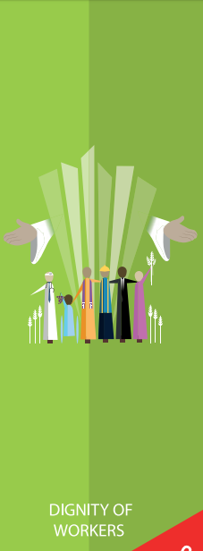
Catholic Social Teaching

Slide 8
Catholic Social Teaching

Slide 9
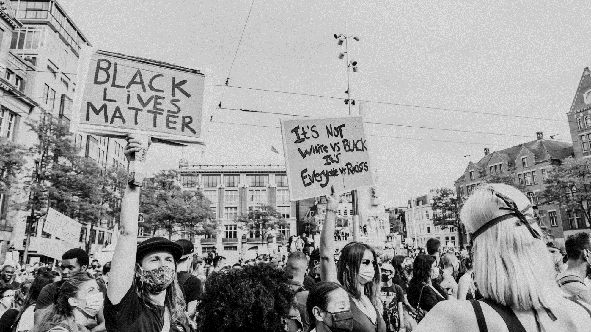
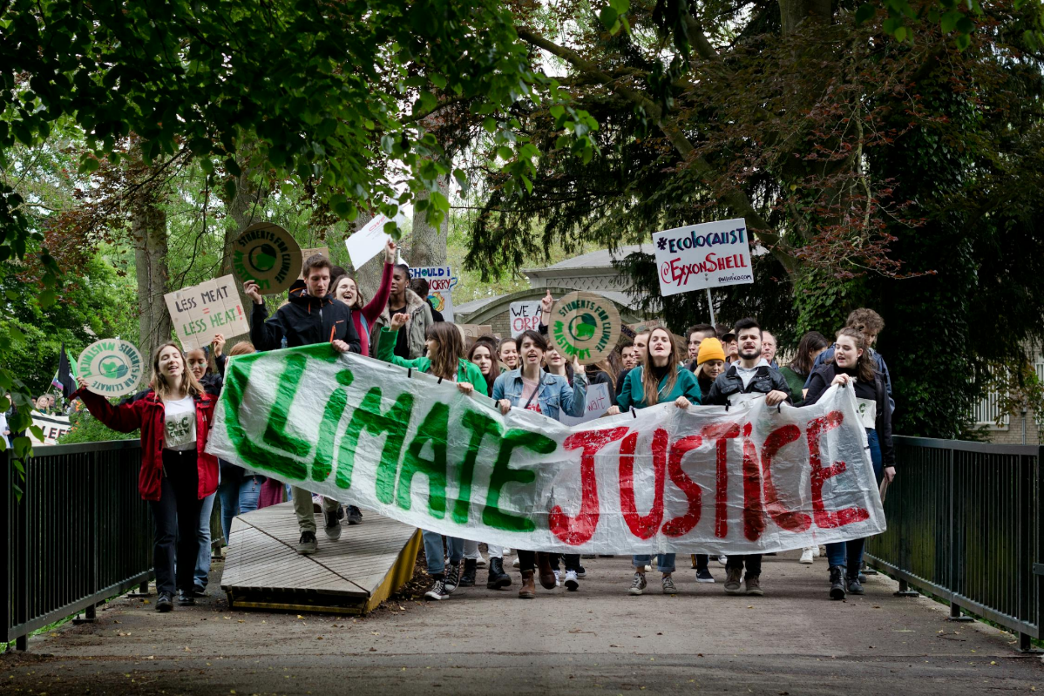
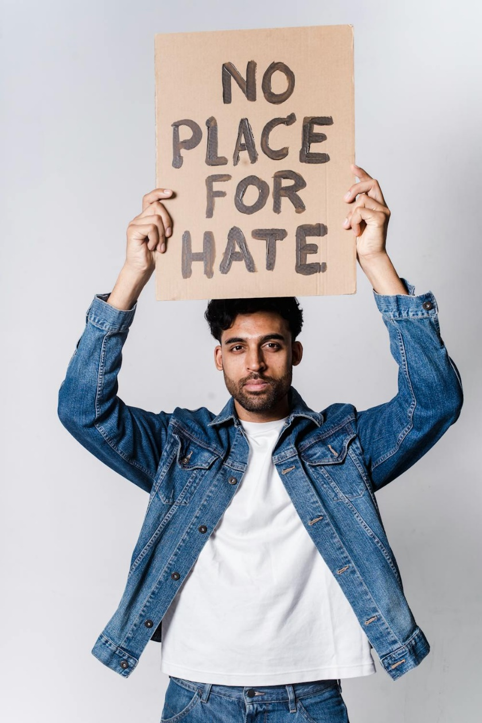
Notes:
How do these protests show solidarity? Solidarity is about standing with others and standing up/speaking out for those who don’t feel they can speak out.

Slide 10
Solidarity and Peace
‘Blessed are the peacemakers, for they will be called sons and daughters of God.’
Matthew 5:9
Who do you think ‘the peacemakers’ are?
Notes:
How are solidarity and peace linked? If everyone is in solidarity, there will be only justice and peace in the world.

Slide 11
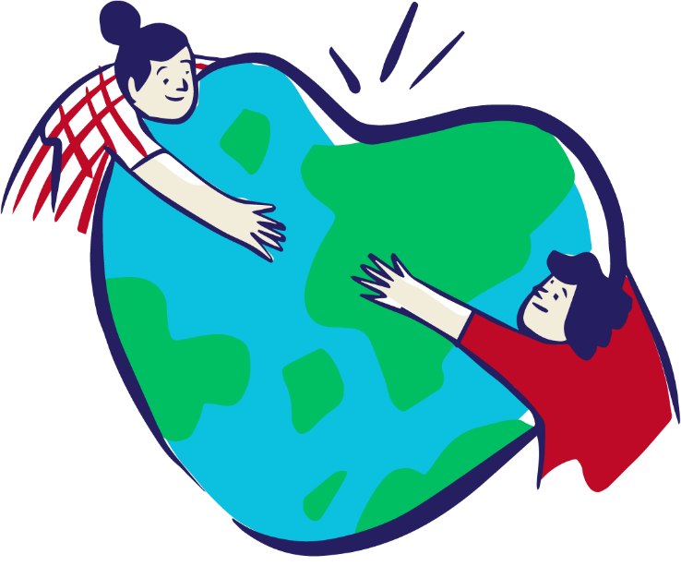
Solidarity and Peace
Peacemakers are people who dedicate their lives and work to making the world more peaceful.
They help reconcile people with God and with one another.

Slide 12
Solidarity and Peace
‘Live in harmony with one another. Do not be proud, but associate with those in need.’
Romans 12:16

Slide 13
Solidarity and Peace
‘Living in right relationship with others brings peace’
Psalm 72

Slide 14
Solidarity and Peace
‘Living rightly means to love one another’
Romans 13: 8-10

Slide 15
Solidarity and Peace
‘If one member of Christ’s body suffers, all suffer. If one member is honoured, all rejoice.’
1 Corinthians 12: 12-26

Slide 16
Solidarity and Peace
‘These are the things you should do: Speak truth, judge well, make peace.’
Zechariah 8:16

Slide 17
Solidarity and Peace
‘[Solidarity] is not a feeling of vague compassion or shallow distress at the misfortunes of others.
It is a firm and persevering determination to commit oneself to…the good of all…because we are all really responsible for all.’
St John Paul II, Sollicitudo Rei Socialis
What do you think St John Paul II meant by this?
Notes:
Why is it important to differentiate between feeling sorry for something and taking action? Have you ever seen or heard of a situation where you feel sorry for the person but are unsure how to help?

Slide 18
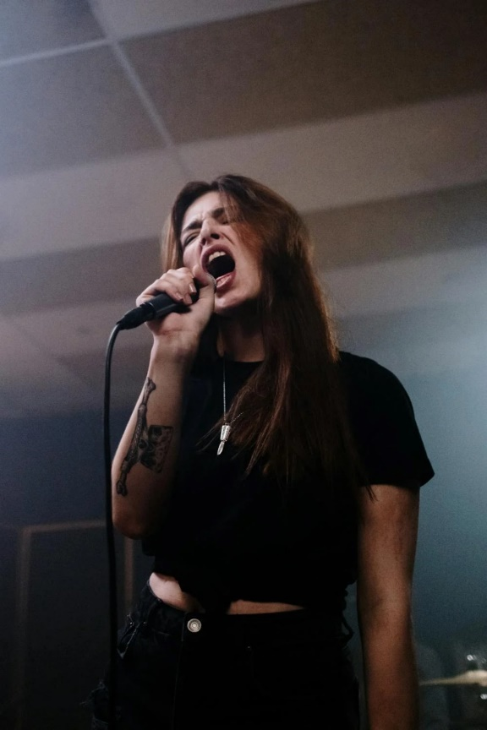
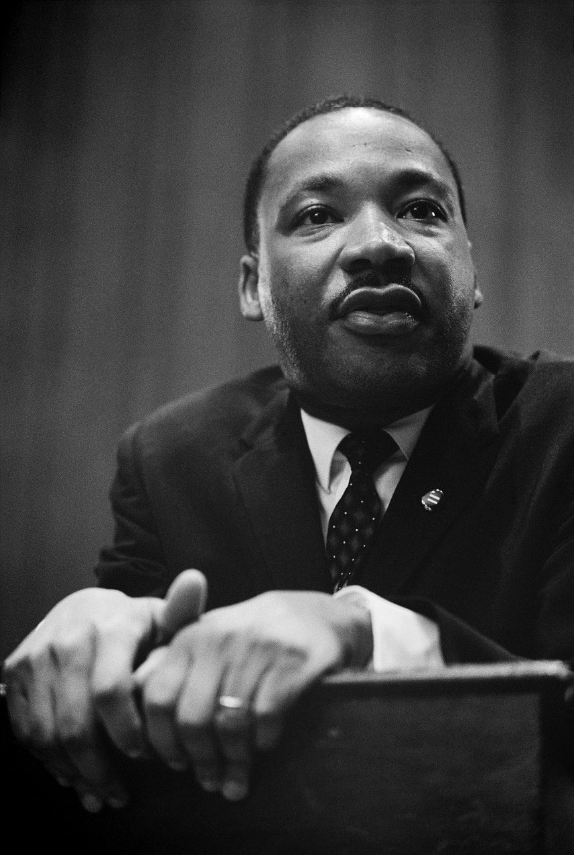
How else do people show solidarity?
Notes:
Vote, make speeches, protest songs, write poetry, march in protests, make posters, sign petitions, sculpt statues/create monuments

Slide 19
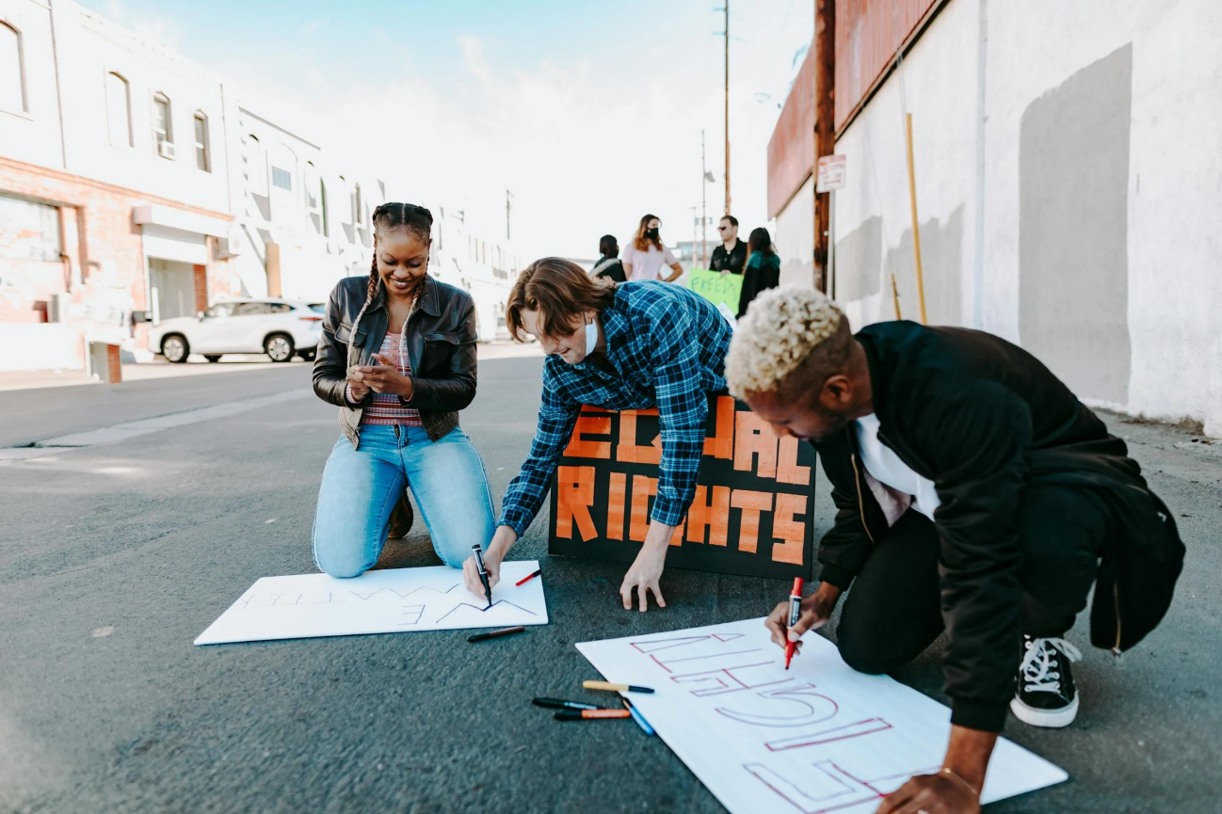
10 Activities for Activism
Notes:
Click the image to link to activities. See plan for detail on how to run this.

Slide 20
Main Activity
How is this showing solidarity? For what cause? Why is this solidarity? How can this lead to peace?
What bible passage does this showing of solidarity put into action?
What issue are you passionate about that you’d like to show solidarity towards? What bible passage are you actioning by doing this? What steps can you take to put this into action?
Notes:
Children to write in books
We would love to see the work your pupils produce (with permissions if necessary). Please email their work to: eduril@rcdow.org.uk

Slide 21
Plenary
‘Peace I leave with you; my peace I give you. I do not give to you as the world gives. Do not let your hearts be troubled and do not be afraid.’
John 14:27
Explain what you think is meant by this.
How can you promote God’s peace in your communities?

